Slide 1
Dynamics of Chromosome Movements During Meiosis in Fission Yeast
Wenwen Huang

Slide 2
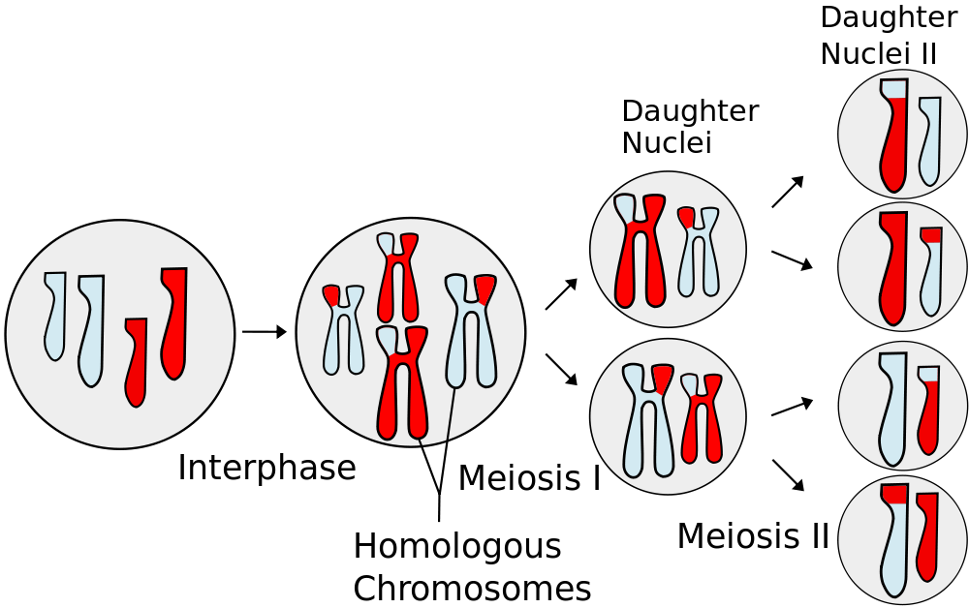
Meiosis
http://en.wikipedia.org/wiki/Meiosis

Slide 3
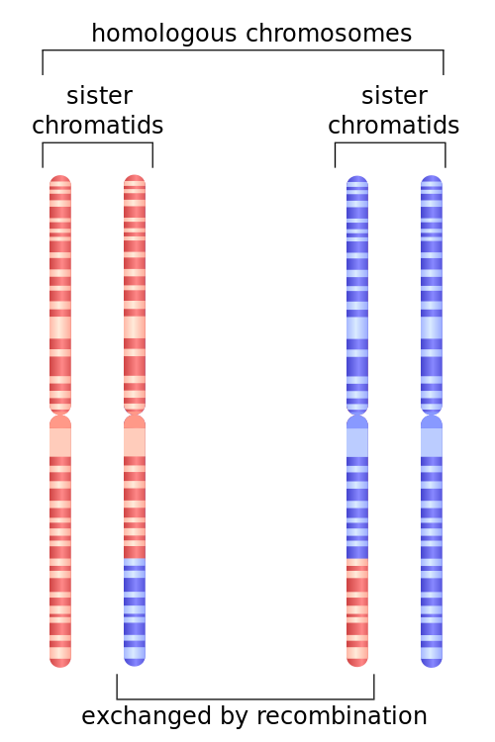
Pairing and Recombination During Nuclear Oscillation
Nuclear oscillation

Slide 4
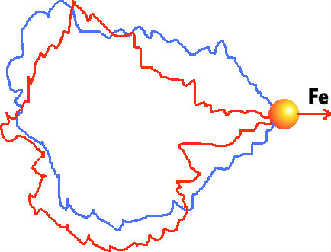
Goal: quantitatively model dynamics of chromosome movements during nuclear oscillation.

Slide 5
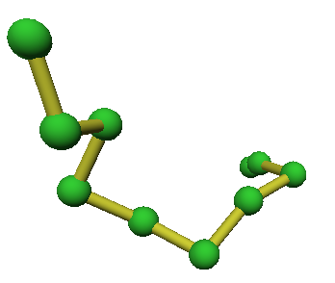
Bead-Rod Model
Brownian Dynamics:
Inertia-less assumption

Slide 6

Animation
Random Chain:

Slide 7

Animation
Random Ring:

Slide 8
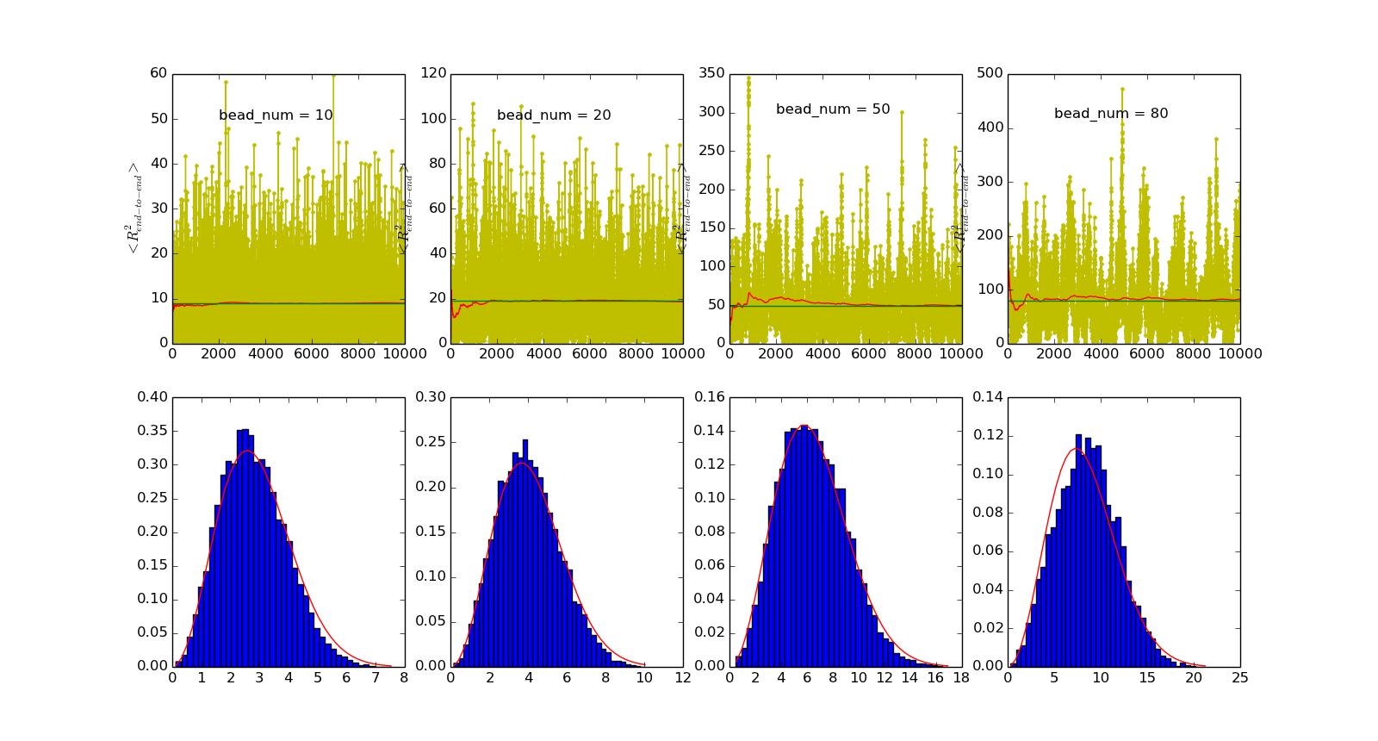
Brownian bead-rod chain equivalent to a realization of random walk

Slide 9
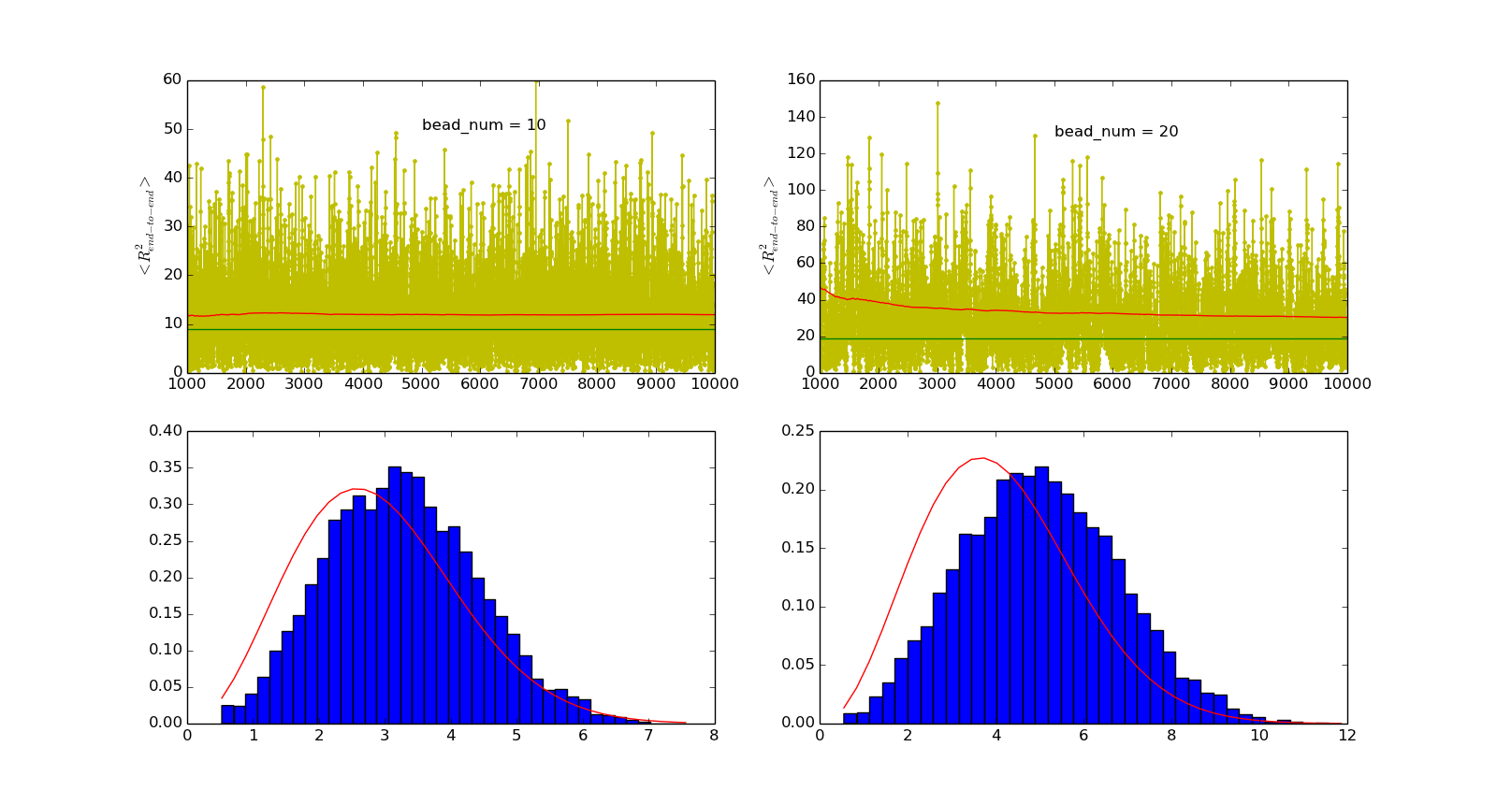
Brownian bead-rod chain equivalent to a realization of random walk
Self-avoiding random walk model accounts for Lennard-Jones potential

Slide 10
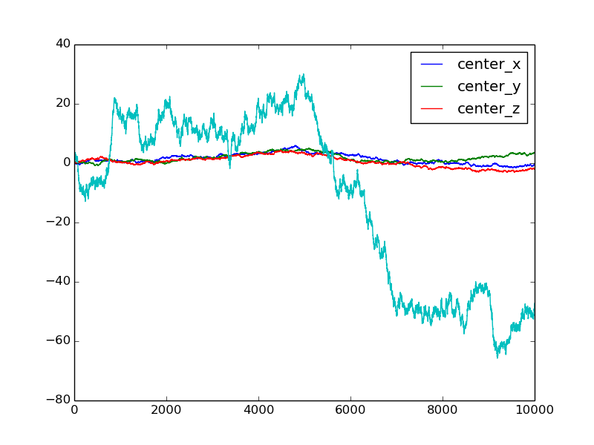
Problem of drift

